Slide 1
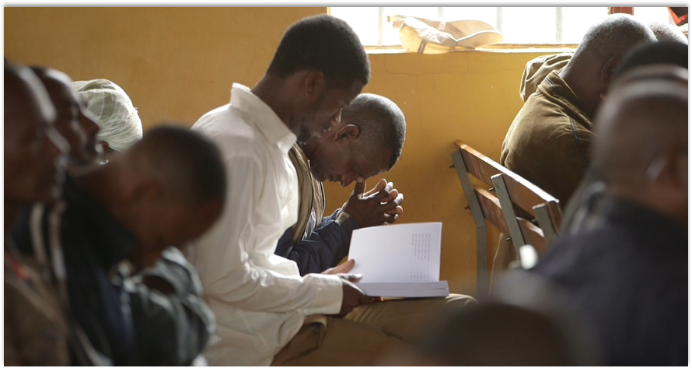
Let us hold fast the confession of our hope without wavering, for He who promised is faithful (Heb. 10:23).
All Scripture is taken from the New King James Version®. © 1982 by Thomas Nelson, Inc. Used by permission. All rights reserved.
Statement of Faith

Slide 2
?
What do you think of when I say the word
“value”?

Slide 3

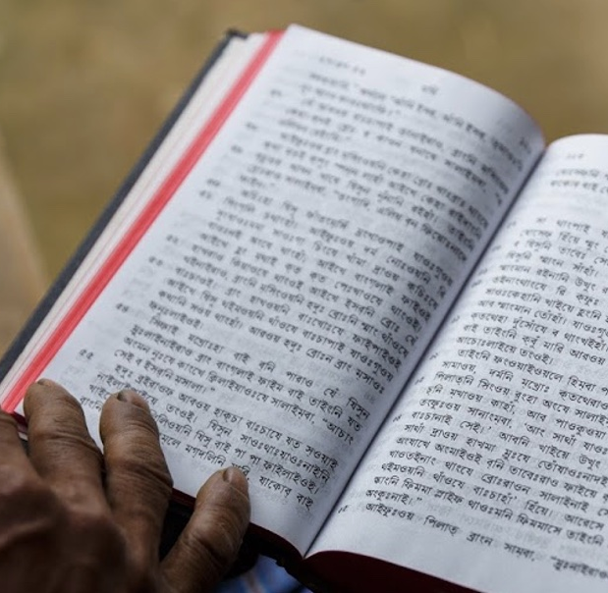
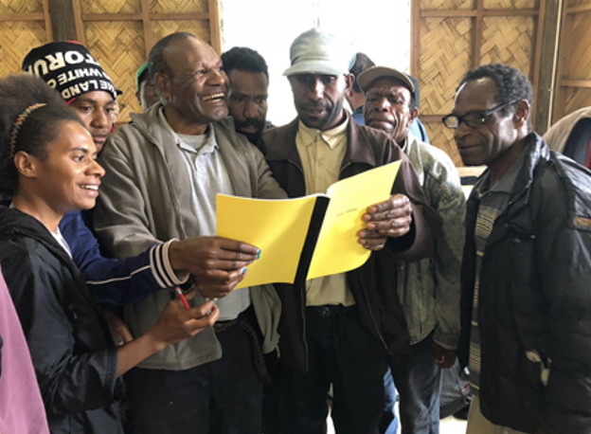
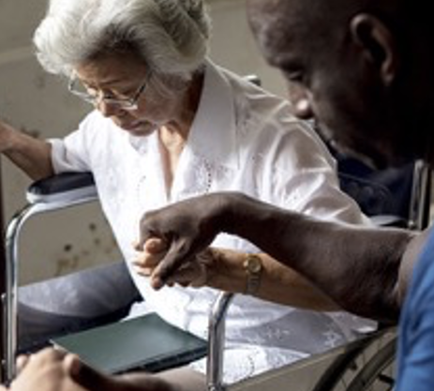
We believe that the Bible is the Word of God.
We believe that the Bible changes lives and advances God’s kingdom.
We believe in the power of the Holy Spirit in the lives of believers.

Slide 4
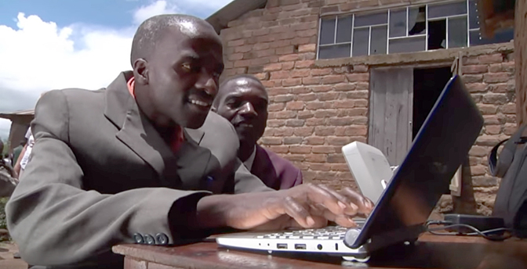
VISION
A Bible in Every Language
MISSION
Involving people
in the advancement of Bible translation

Slide 5
?
How do our vision and mission statement connect with our values?

Slide 6
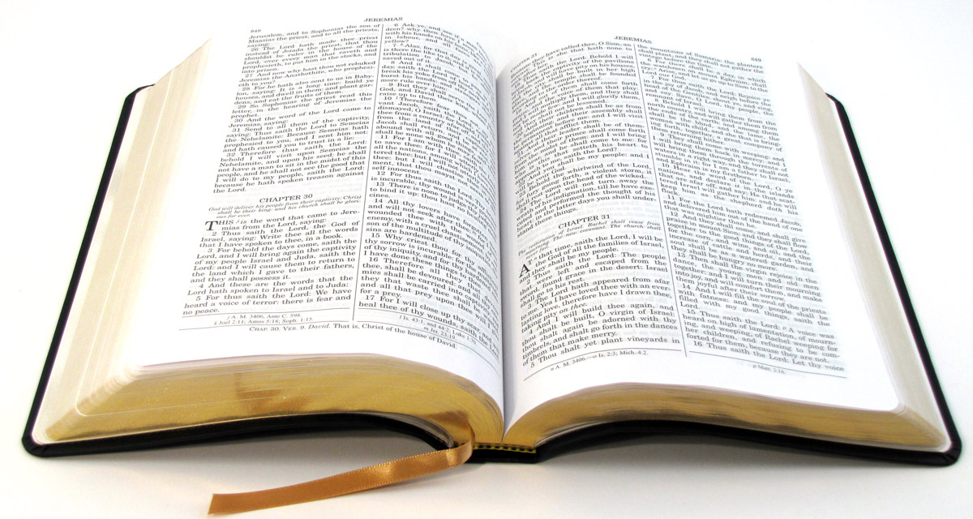
Primary Beliefs
Statement of Faith

Slide 7
We believe:
The Bible is divinely inspired by God and has final authority.
This means that the Bible came directly from God Himself, and it is completely true. It should be honored above any other source of information.
2Timothy 3:16: All Scripture is given by inspiration of God, and is profitable for doctrine, for reproof, for correction, for instruction in righteousness,
John 17:17: Sanctify them by Your truth. Your word is truth.

Slide 8
We believe:
2. God is one and exists in three persons: God the Father, God the Son, and God the Holy Spirit.
This means that there is only one God, and He reveals Himself to us in three different roles. He is the Father, He is the Son Jesus Christ, and He is the Holy Spirit.
Deuteronomy 6:4: Hear, O Israel: The Lord our God, the Lord is one!
John 10:30: I and My Father are one.
1 Peter 1:10-11: Of this salvation the prophets have inquired and searched carefully, who prophesied of the grace that would come to you, ¹¹ searching what, or what manner of time, the Spirit of Christ who was in them was indicating when He testified beforehand the sufferings of Christ and the glories that would follow.

Slide 9
We believe:
3. Because of the fall of man, all humans are sinful and in need of salvation.
This means that everyone has sinned, so we are all separated from God. There is nothing we can do on our own to earn eternal life or heaven.
Romans 5:12: through one man sin entered the world, and death through sin, and thus death spread to all men, because all sinned

Slide 10
We believe:
4. The death of Christ is a substitute for sinners and provides for the cleansing of those who believe.
This means that Jesus died as punishment for the sins of all humanity. His death counts as payment for us so that we can be forgiven.
1 John 2:2: And He Himself is the propitiation for our sins, and not for ours only but also for the whole world.

Slide 11
We believe:
5. By God’s grace, through faith, man receives salvation as a free gift because of Jesus’ death and resurrection.
This means that, because of Jesus’s sacrifice, we can be forgiven and saved. We cannot earn this, but we receive it by putting our faith in Jesus.
Romans 3:24-25a: being justified freely by His grace through the redemption that is in Christ Jesus, ²⁵ whom God set forth as a propitiation by His blood, through faith...

Slide 12
We believe:
6. The resurrection of all–the saved to eternal life and the lost to eternal punishment.
This means that everyone will be brought back to life one day. Those who trusted Jesus for salvation will live with him forever. Those who did not trust him will be punished forever.
Acts 24:15b: … that there will be a resurrection of the dead, both ofthe just and the unjust.
Matthew 25:46: And these will go away into everlasting punishment, but the righteous into eternal life.

Slide 13
We believe:
The Bible is divinely inspired by God and has final authority.
God is one and exists in three persons: God the Father, God the Son, and God the Holy Spirit.
Because of the fall of man, all humans are sinful and in need of salvation.
The death of Christ is a substitute for sinners and provides for the cleansing of those who believe.
By God’s grace, through faith, man receives salvation as a free gift because of Jesus’ death and resurrection.
The resurrection of all–the saved to eternal life and the lost to eternal punishment.

Slide 14
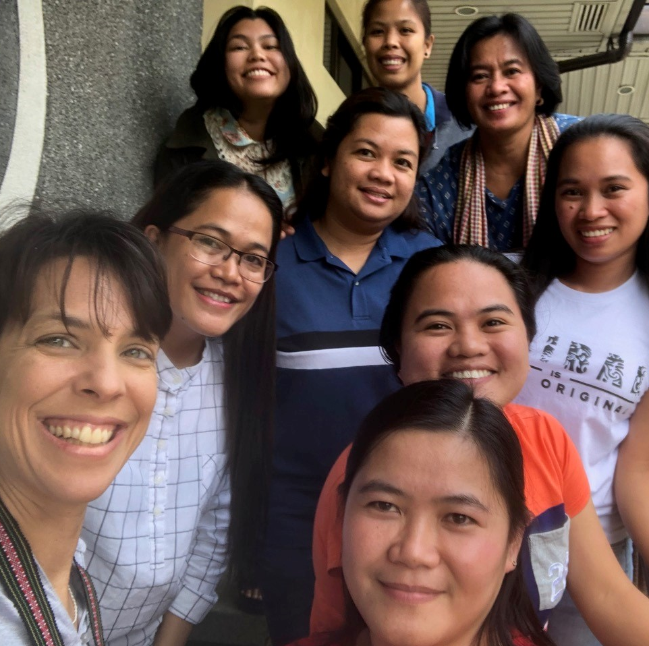
Statement of Faith
encourages:
unity
what is most important
a foundation for working together

